Slide 1


Attention Is All You Need
Department of Information and Communication Technology
Presented By :-
Ritesh Sanchala - 92200133001
Fenil Vadher - 92200133023
Aryan Langhanoja - 92200133030
Subject :- Generative AI (01CT0711)
Semester - 7
Faculty :- Prof. Abhinay Yadav

Slide 2
Abstract
New Architecture: Replaces recurrence & convolutions with pure attention mechanisms.
Performance: Outperforms prior models on machine translation (28.4 BLEU En→De, 41.8 BLEU En→Fr).
Efficiency: More parallelizable & significantly faster training (3.5 days on 8 GPUs).
Generalization: Extends beyond translation, effective in tasks like English constituency parsing.

Slide 3
Introduction
RNNs, LSTMs & GRUs: Established as state-of-the-art for sequence modeling (e.g., language modeling, machine translation).
Limitation: Sequential computation (hidden states depend on previous steps) → poor parallelization, memory bottlenecks at longer sequences.
Improvements Tried: Factorization tricks & conditional computation increased efficiency but couldn’t remove the sequential constraint.
Role of Attention: Enables modeling long-range dependencies more effectively, but usually combined with recurrent networks.
Transformer Proposal: Removes recurrence completely, uses only attention to model global dependencies.
Impact: Highly parallelizable, faster training (as little as 12 hrs on 8 GPUs) while achieving state-of-the-art translation quality.

Slide 4
Background
Earlier Models:
Extended Neural GPU, ByteNet, and ConvS2S reduce sequential computation using CNNs.
Computational cost grows with distance between positions (linear for ConvS2S, logarithmic for ByteNet).
Makes long-range dependencies harder to capture.
Transformer Advantage:
Relates any two positions in constant number of operations.
Uses Multi-Head Attention to counteract resolution loss from averaging.
Self-Attention:
Captures relationships within a single sequence to build representations.
Proven effective in reading comprehension, summarization, entailment, and sentence embeddings.
Innovation:
First transduction model built entirely on self-attention, without RNNs or CNNs.

Slide 5
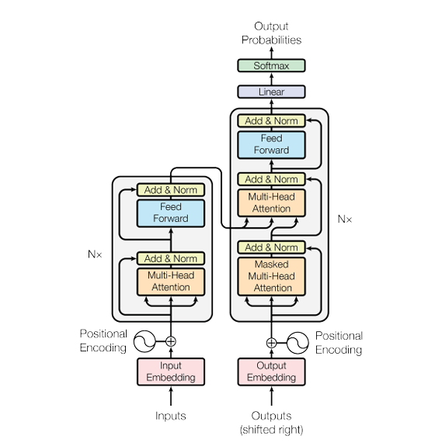
Model Architecture
Encoder: Processes input sequence into hidden representations using layers of self-attention and feed-forward networks.
Decoder: Generates output sequence step by step, attending to both previous outputs and encoder representations.
Positional Encoding: Adds order information to token embeddings, since self-attention itself is position-agnostic.
Multi-Head Attention: Runs multiple attention mechanisms in parallel to capture diverse relationships between tokens.
Masked Multi-Head Attention: Prevents a token from “seeing” future tokens, ensuring correct autoregressive decoding.
Feed Forward Network: A simple fully connected neural network applied independently to each position for transformation.

Slide 6
Encoder and Decoder Stacks
Encoder
6 identical layers (N = 6).
Each layer has: • Multi-head self-attention sub-layer. • Position-wise feed-forward network.
Uses residual connections + layer normalization: LayerNorm(x + Sublayer(x))
Output dimension: d_model = 512 for all sub-layers & embeddings.
Decoder
6 identical layers (N = 6).
Each layer has: • Masked multi-head self-attention (prevents looking ahead). • Encoder–decoder attention (attends to encoder output). • Feed-forward network.
Residual connections + layer normalization applied at each sub-layer.
Ensures predictions at position i depend only on outputs < i.

Slide 7
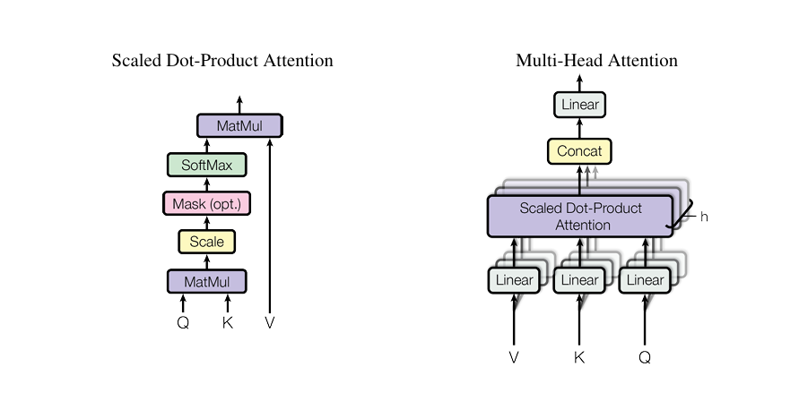
Attention

Slide 8

Scaled Dot-Product Attention
Scaled Dot-Product Attention
Takes Queries (Q), Keys (K), Values (V) as input.
Computes similarity: QKᵀ, scales by 1/√dₖ, then applies softmax to get weights.
Prevents large dot products that push softmax into low-gradient regions.
Formula:
Comparison with Additive Attention
Additive Attention: Uses a feed-forward network with a hidden layer.
Dot-Product Attention: Much faster & memory-efficient with matrix multiplication.
For small dₖ, both perform similarly; for large dₖ, scaling is critical.
Efficiency Advantage
Dot-product with scaling leverages highly optimized GPU matrix operations.
Makes training more parallelizable compared to additive attention.

Slide 9
Multi-Head Attention
Concept
Instead of one attention function with full dmodel dimensions, queries, keys, and values are linearly projected h times.
Each projection maps to dk, dk, dv dimensions, enabling multiple attention computations in parallel.
Mechanism
Each head performs scaled dot-product attention independently.
Outputs from all heads are concatenated and passed through a projection matrix WO.
Benefits
Allows the model to attend to different representation subspaces at different positions.
Overcomes the limitation of a single head, where averaging weakens representational capacity.
Implementation (Paper Setup)
h = 8 heads, each with dk = dvr model/h = 64.
Computational cost remains comparable to single-head attention due to reduced dimensions per head.

Slide 10
Applications of Attention
Uses of Multi-Head Attention in Transformer
Encoder-Decoder Attention
Queries come from the decoder, keys & values from the encoder outputs.
Lets each decoder position attend to all input positions (like seq2seq attention).
Encoder Self-Attention
Queries, keys, and values all from the encoder’s previous layer.
Each encoder position attends to all other positions in the input sequence.
Decoder Self-Attention
Queries, keys, and values all from the decoder’s previous layer.
Uses masking to block access to future tokens, preserving auto-regressive generation.

Slide 11

Position-wise Feed-Forward Networks
Structure
Each encoder & decoder layer includes a fully connected feed-forward network.
Applied independently & identically to each position.
Composition
Two linear transformations with a ReLU activation in between.
Equivalent to 1×1 convolutions across positions.
Parameters
Input/Output dimensionality: dmodel = 512.
Inner-layer dimensionality: dff = 2048.
Parameters differ across layers, but shared across positions.

Slide 12
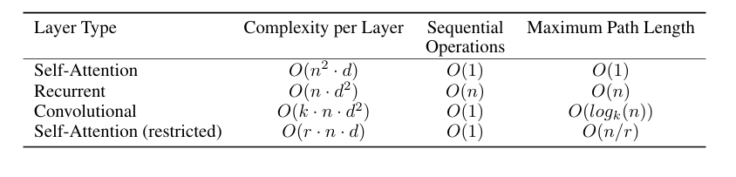
Embeddings and Softmax
Embeddings & Output Projection: Input/output tokens are mapped to dmodel-dimensional embeddings, with weights shared between input embeddings, output embeddings, and the pre-softmax linear layer; embeddings are scaled by √dmodel.
Table 1: Maximum Path lengths, per-layer complexity and minimum number of sequential operations for different layer types. n is the sequence length, d is the representation dimension, k is the kernel size of convolutions and r the size of the neighborhood in restricted self-attention.

Slide 13

Positional Encoding
Positional Encoding: Adds position information to input embeddings (same dimension as dmodel) so the model can capture sequence order without recurrence or convolution.
Sinusoidal Encoding: Each position is encoded using sinusoids with wavelengths in a geometric progression (2π → 10000·2π), allowing the model to capture relative positions.
Property: For any offset k, PE(pos+k) can be expressed as a linear function of PE(pos), enabling easy learning of relative attention.
Comparison: Learned positional embeddings perform similarly, but sinusoidal encoding was chosen for its potential generalization benefits.

Slide 14
Why Self-Attention
Self-Attention Efficiency: Connects all positions in constant sequential steps, unlike RNNs (O(n)) or CNN's that need many stacked layers.
Parallelism Advantage: Processes all tokens simultaneously, while RNNs are inherently sequential and limit parallelization.
Long-Range Dependencies: Provides the shortest path between distant tokens, making global context learning easier than RNNs/CNNs.
Computational Complexity: Faster than RNNs when sequence length n < d; CNNs are often more costly, even with separable convolutions.
Interpretability: Attention heads specialize in syntactic and semantic roles, offering insights into sentence structure.

Slide 15
Training
Training Data and Batching :- The Transformer was trained on WMT 2014 En–De (4.5M pairs, 37k BPE vocab) and En–Fr (36M pairs, 32k word-piece vocab) with batches of ~25k source and ~25k target tokens.
Hardware and Schedule :- The Transformer base model trained on 8 P100 GPUs in ~12 hours (100k steps), while the big model required 3.5 days (300k steps).
Optimizer :- They trained with Adam (β₁=0.9, β₂=0.98, ε=10⁻⁹) using a learning rate schedule: linear warm-up for 4000 steps, then decay by inverse square root of step number.
Residual Dropout: Dropout (rate = 0.1) is applied to sub-layer outputs and to the sum of embeddings + positional encodings before normalization in both encoder and decoder.
Label Smoothing (ε = 0.1): Slightly increases perplexity by making predictions less confident, but improves overall accuracy and BLEU score.

Slide 16
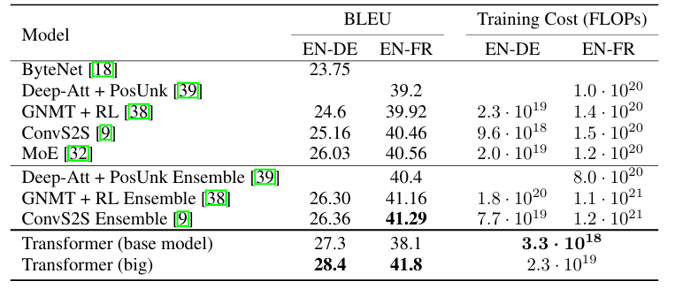
Training(Continue)
Regularization
Table 2: The Transformer outperforms previous state-of-the-art models on WMT’14 English→German and English→French tasks, achieving higher BLEU scores with much lower training cost.

Slide 17
Results
English→German: Transformer (Big) sets new SOTA with 28.4 BLEU, trained in 3.5 days (8 GPUs).
English→French: Achieves 41.0 BLEU, at <25% training cost of prior models.
Training Setup: Checkpoint averaging + beam search (size 4, α=0.6).
Ablations: Balanced heads & larger models help; dropout effective; sinusoidal vs learned encoding → similar results.

Slide 18
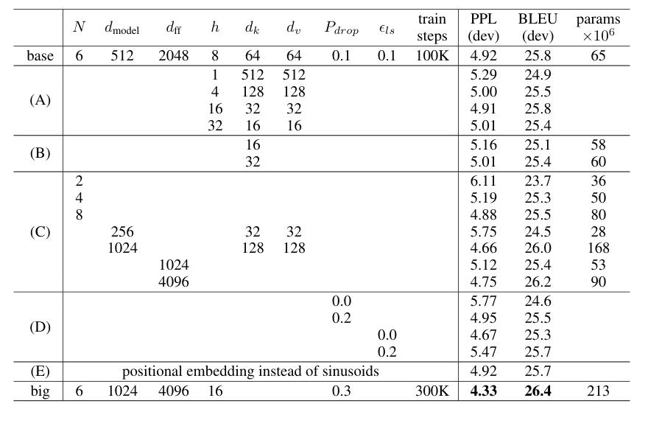
Results

Slide 19
Results
English→German: Transformer (Big) sets new SOTA with 28.4 BLEU, trained in 3.5 days (8 GPUs).
English→French: Achieves 41.0 BLEU, at <25% training cost of prior models.
Training Setup: Checkpoint averaging + beam search (size 4, α=0.6).
Ablations: Balanced heads & larger models help; dropout effective; sinusoidal vs learned encoding → similar results.

Slide 20
Results
Task & Challenge: Output has strong structural constraints and is longer than input; small-data regimes are difficult for RNN seq2seq models.
Model & Training: 4-layer Transformer, dmodel = 1024, trained on WSJ (40K sentences) and semi-supervised corpus (~17M sentences).
Settings: Vocabulary 16K (WSJ) / 32K (semi-supervised); used dropout, attention & residual tuning; beam size 21, length penalty α = 0.3.
Results: Outperforms most previous models, including Berkeley Parser, even with small WSJ-only training set.
Observation: Shows strong generalization to non-translation tasks without task-specific architecture changes.

Slide 21
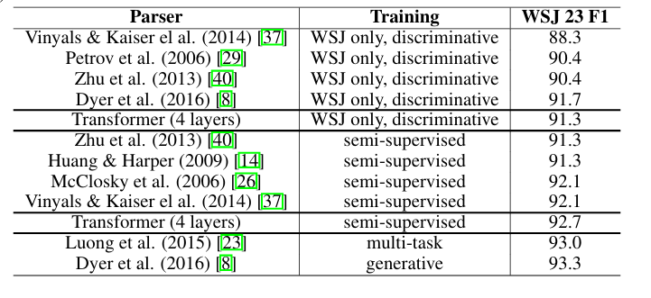
Results

Slide 22
Conclusion
Transformer Overview: First sequence transduction model using only attention, replacing recurrent layers with multi-headed self-attention.
Performance: Achieves state-of-the-art translation on WMT 2014 English→German and English→French; outperforms previous ensembles.
Efficiency: Trains significantly faster than RNN- or CNN-based architectures.
Future Directions: Extend to other modalities (images, audio, video), explore local/restricted attention, and reduce sequential generation.
Open Source: Training and evaluation code available at https://github.com/tensorflow/tensor2tensor

Slide 23


